Slide 1
The Evolution of Artificial Intelligence: From Concept to Reality
A Timeline of Key Milestones and Innovations
Group 4
Members:
Kanishk Sharma
Battina Gopi Chand
MacDonald Udokoro
Akhil Nimmagadda
Navid Gholizadeh

Slide 2
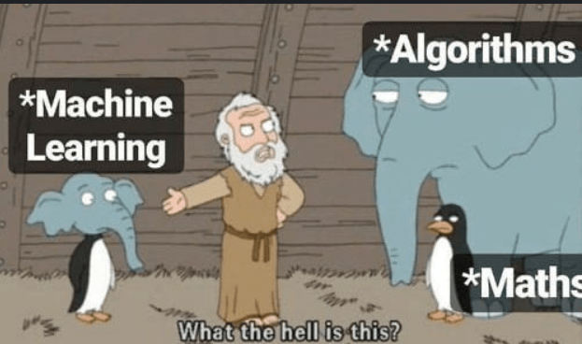
The Birth of AI (1950s–1970s)
1950: Alan Turing proposes the Turing Test
1956: The term Artificial Intelligence coined at the Dartmouth Conference
1966: ELIZA chatbot developed: first natural language program
1970s: Expert systems and symbolic AI rise
Notes:
These early decades laid the conceptual foundation for AI: researchers aimed to make machines ‘think’ using logic and symbols.
Turing asked can machines think?

Slide 3
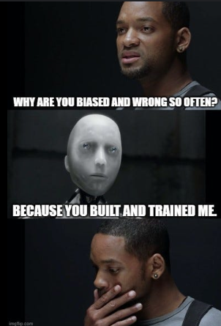
The AI Winters (1970s–1990s)
AI Winter I (1974–1980): Funding cuts due to unmet expectations
AI Winter II (1987–1993): Collapse of expert systems market
Impact: Shift in research focus, reduced public trust and investment
Notes:
High hopes met limited computing power and unrealistic goals, leading to two major AI winters. periods when interest and funding dried up

Slide 4
The Machine Learning Revival (1990s–2010s)
1997: IBM Deep Blue defeats world chess champion Garry Kasparov
2006: Geoffrey Hinton popularizes Deep Learning
2011: IBM Watson wins Jeopardy!
2012: AlexNet wins ImageNet: the deep learning boom begins
Notes:
Machine learning replaced symbolic reasoning, and computing power finally caught up. Paving the way for neural networks and data-driven AI.
Boom happs from synergy between massive data sets and increased computing

Slide 5
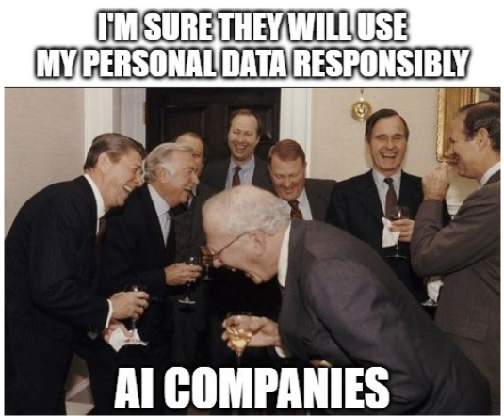
Modern AI & Cloud Era (2010s–Present)
2016: AlphaGo beats Lee Sedol — reinforcement learning milestone
2018–2020: Cloud AI from Google, Amazon, and Microsoft democratizes access
2022–2025: Generative AI (GPT-4, Claude, Gemini) revolutionizes industries
Leaders: OpenAI, DeepMind, Google, DataRobot
Notes:
Today, AI runs on scalable cloud infrastructure and deep neural models. transforming healthcare, finance, and even creative industries.
However ethical considerations - bias and fairness, privacy, accountability,

Slide 6
Thank you for listening!
Questions? Just ask ChatGPT :)

